Slide 1
Introduction to ReactJS
Course Code: CSC 4182
Course Title: Advanced Programming In Web Technologies
Dept. of Computer Science
Faculty of Science and Technology
Lecture No: | 2 | Week No: | 08 | Semester:
Lecturer: | Sazzad Hossain; sazzad@aiub.edu

Slide 2
Lecture Outline
Full Stack Web Development
Frontend Libraries & Frameworks
Backend Frameworks
What is Tech Stack
3NP Stack
API(Application Programming Interface)
REST API
Course Logistics
Node.js
Postman

Slide 3
What is ReactJS?
ReactJS is a JavaScript library created by Facebook.
React is a tool for building UI components.
React creates a VIRTUAL DOM in memory.
Instead of manipulating the browser's DOM directly, React creates a virtual DOM in memory, where it does all the necessary manipulating, before making the changes in the browser DOM.
React only changes what needs to be changed!
React finds out what changes have been made, and changes only what needs to be changed.

Slide 4
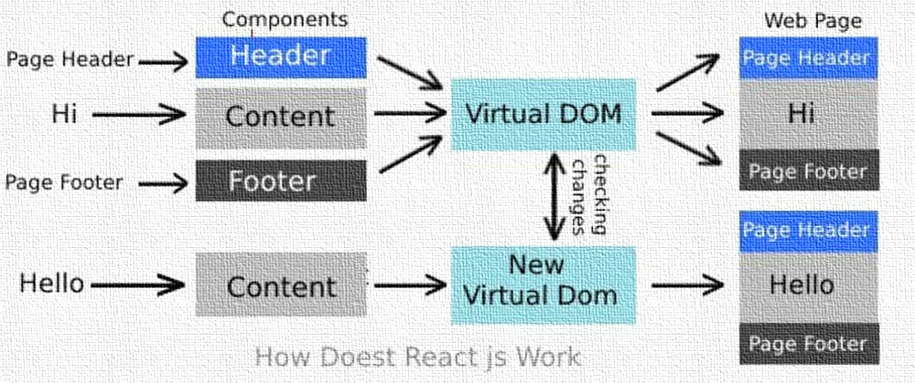
How does React Work?

Slide 5
React.JS History
Current version of React.JS is V19.0.0 (April 2025).
Initial Release to the Public (V0.3.0) was in July 2013.
React.JS was first used in 2011 for Facebook's Newsfeed feature.
Facebook Software Engineer, Jordan Walke, created it.

Slide 6
ES6 pre-requisite of ReactJS
What is ES6?
ES6 stands for ECMAScript 6.
ECMAScript was created to standardize JavaScript, and ES6 is the 6th version of ECMAScript, it was published in 2015, and is also known as ECMAScript 2015.
React uses ES6, and you should be familiar with some of the new features like:
Arrow Functions
Variables (let, const, var)
Array Methods like .map()
Destructuring
Modules
Ternary Operator

Slide 7
References
W3Schools Online Web Tutorials, URL: http://www.w3schools.com
Next.js, URL: https://nextjs.org/
Mozilla Developer Networks, URL: https://developer.mozilla.org/

Slide 8
Thank You!

